Slide 1
Introduction to Image Processing with MATLAB
Oliver Wieben &
Wally Block
BME / Medical Physics 530
Medical Imaging Systems
Notes:
Tuesday 30 November 1999
RSNA, Chicago
Observer Evaluation of 3D MR DSA Preview Images

Slide 2
Overview
Getting Help
2D Matrix / Image
  Coordinate system
  Display
  Storing images
2D Functions
Discrete Fourier Transform
  1D DFT
  fftshift
  2D DFT: zero-filling and shifting the image

Slide 3
Getting Started
Get a CAE account
Log in (Windows or Unix)
Create a directory ‘ImLab’
Open Webbrowser and goto course page
  http://zoot.radiology.wisc.edu/~block/bme_530.html
Goto ‘Lecture Material’
Download
  matlab_intro.m
  example.fig, example.mat, example.tif
Start Matlab
  Change to directory ‘Imlab’
    Either >>cd ImLab
    Or use the path browser

Slide 4
Getting Help in Matlab
Online Help
  Help Browser (? In toolbar or >>helpbrowser)
  Help Functions ( >>help functionname )
  Matlab website: www.mathworks.com
  Demos
Documentation
  Online as pdf files
  Checkout at CAE

Slide 5
2D Matrix
2D matrix has M rows and N columns
Example
  >>m=zeros(400,200);
  >>m(1:50,1:100) = 1;
Note:
  Index 1 to M, not 0 to M-1
  Origin of coordinate system is in upper left corner
  Row index increases from top to bottom
  Coordinate system is rotated in respect to ‘standard’ x-y coordinate system
c
1
2
3
…
N
1
2
3
r
…
M

Slide 6
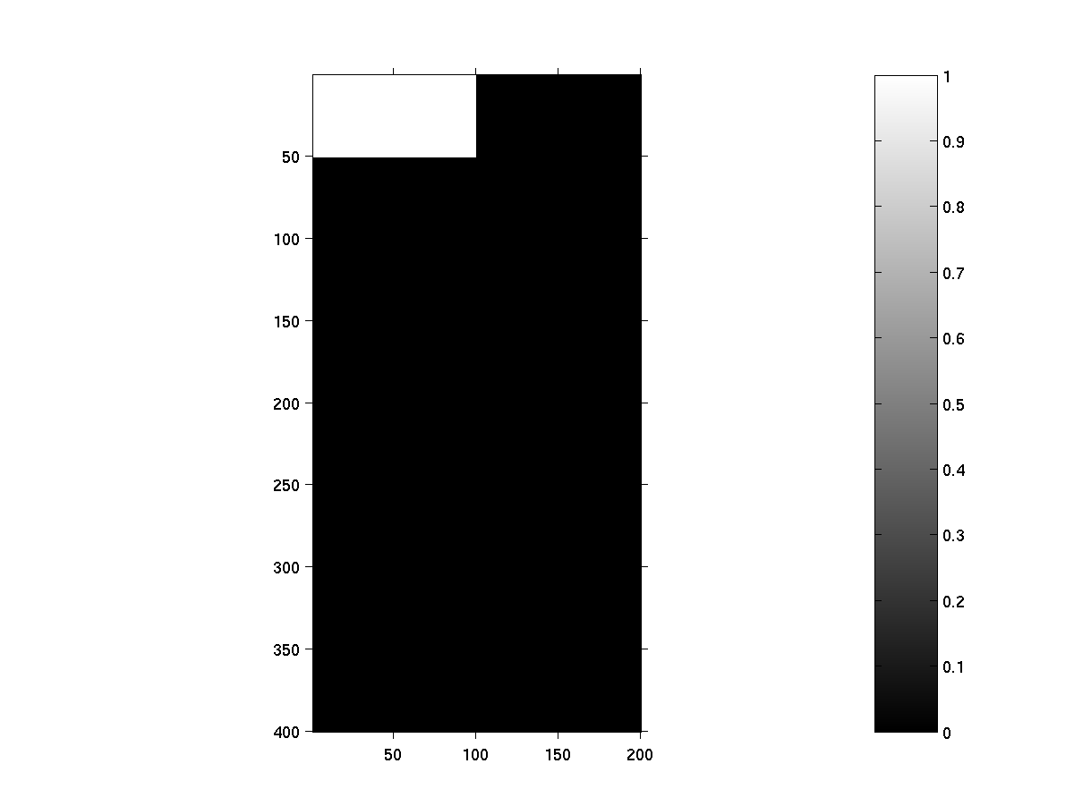
Image Display
Display a 2D matrix as an image
  >>image(m)
  >>imagesc(m)
  >>imshow(m)
imshow is recommended by MATLAB for image processing
Image has MxN pixels = picture elements = dots on display
Test the following commands
  >>axis on
  >>colorbar
  >>colormap(jet)
  >>colormap(gray)

Slide 7
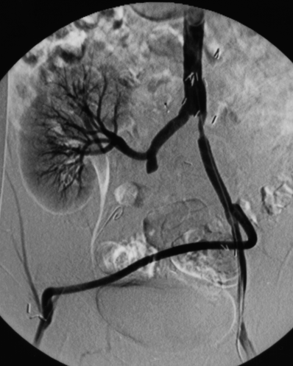
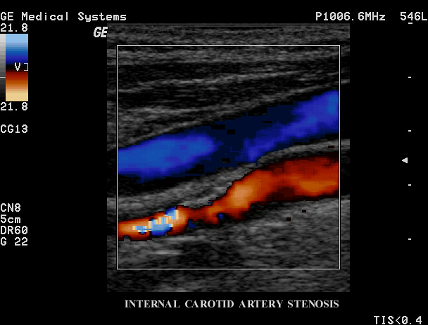
Image Types
Medical images are mostly represented as grayscale images
  Human visual system resolves highest spatial resolution for grayscale contrast
  Color is sometimes used to superimpose information on anatomical data

Slide 8

Save Image Matrix
MATLAB binary format
  >>save example m
  -> writes out example.mat
Standard image format (bmp,tiff,jpeg,png,hdf,pcx,xwd)
  >>imwrite(m,’example.tif’,’tif’)
  -> writes out example.tif
  Warning: imwrite expects data in range [0…1]
  If data range outside this [0…1], use mat2gray
  >>m_2 = mat2gray(m);
  >>imwrite(m_2,’example.tif’,’tif’)

Slide 9
Save Figure (incl. labels etc)
Save in Matlab Figure Format:
  >File>Save As> in Figure Window
  -> writes out example.fig
Standard image formats
  >File>Export in Figure Window
      E.g. jpg, tif, png, eps, …
  Alternatively, use print, e.g.
  >>print –deps2 example.eps

Slide 10
Loading 2D Data and Images
Load matrix from MATLAB binary format
  >>load example (loads example.mat)
Load matrix from standard image format
  >>m_in = imread(’example.tif’,’tif’);
  To check on an image:
  >>imfinfo(’example.tif’,’tif’)
Load figure from Matlab Figure Format (*.fig):
  >File>Open> ‘example.fig’ in Figure Window
->Check loaded matrices
  >>whos

Slide 11
Some Common Image Formats
TIF (TIFF)
  Very common, compatible, all purpose image format
  Allows for lossless compression
JPEG
  Allows for lossy compression (small file size)
  Very common for internet
PNG (portable network graphics)
  Good for saving MATLAB images for importing into Microsoft docuuments such as Word
Dicom
  THE medical imaging format
  Lots of header information (patient name & ID, imaging parameters, exam date, …) can be stored
  Allows for lossy and lossless compression
  Not supported by MATLAB!!!
EPS (Encapsulated Postscript)
  Graphics format rather than an image format
  Great for best quality print results
  Large file size

Slide 12
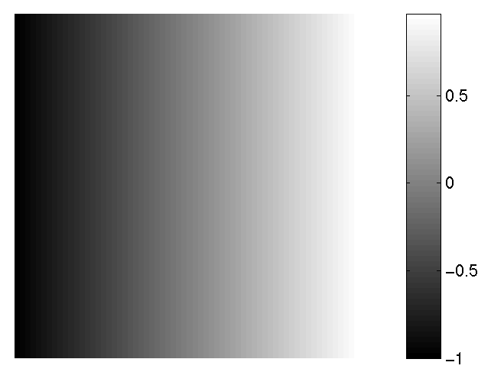
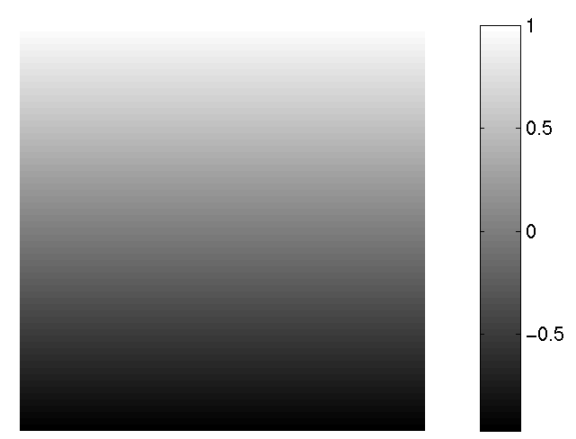
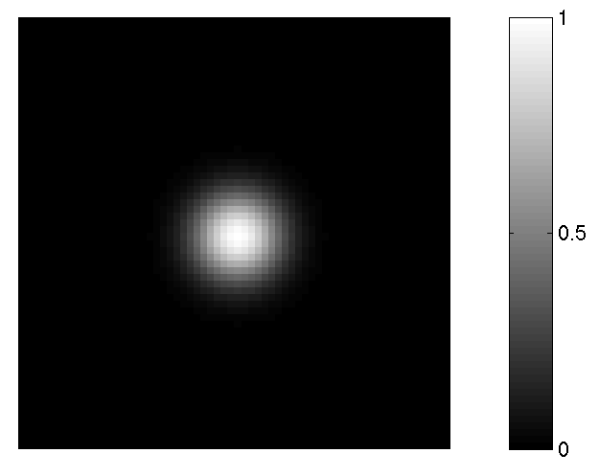
2D Functions
Create a matrix that evaluates 2D Gaussian: exp(-π/2(x²+y²)/σ²)
  >>ind = [-32:1:31] / 32;
  >>[x,y] = meshgrid(ind,-1*ind);
  >>z = exp(-pi/2*(x.^2+y.^2)/(.25.^2));
  >>imshow(z)
  >>colorbar
x
y
y’
-1
64x64 matrix
x’
0
31/32
-1

Slide 13
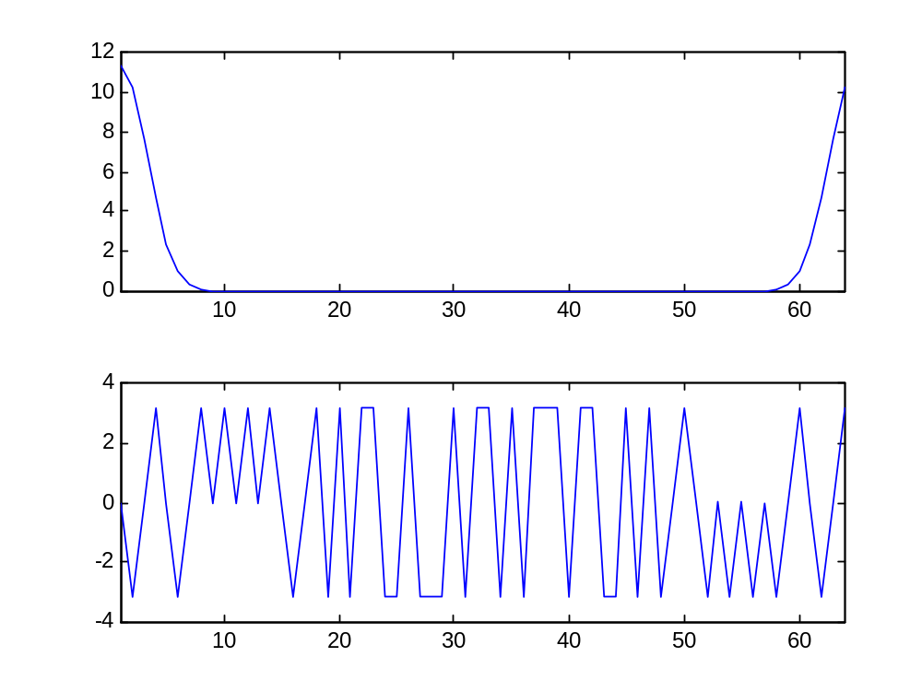
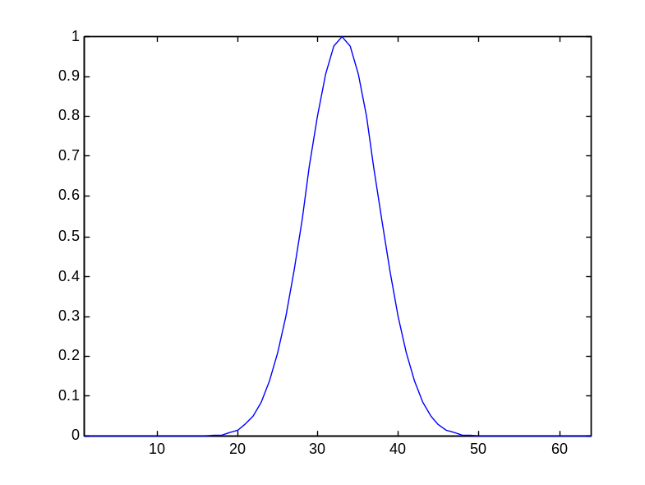
FT Conventions - 1D
1D Fourier Transform
  >>l = z(33,:);
  >>L = fft(l);
abs (L)
l
phase (L)
1
33
64
1
33
64
sample #
sample #
0
x_{max}
0
f_{N}/2
f_{N}
x [Matlab]
u

Slide 14
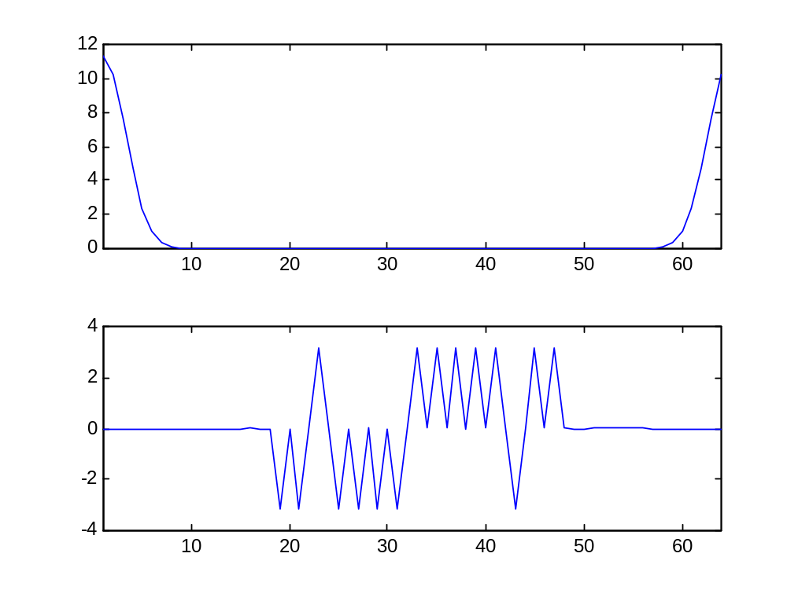
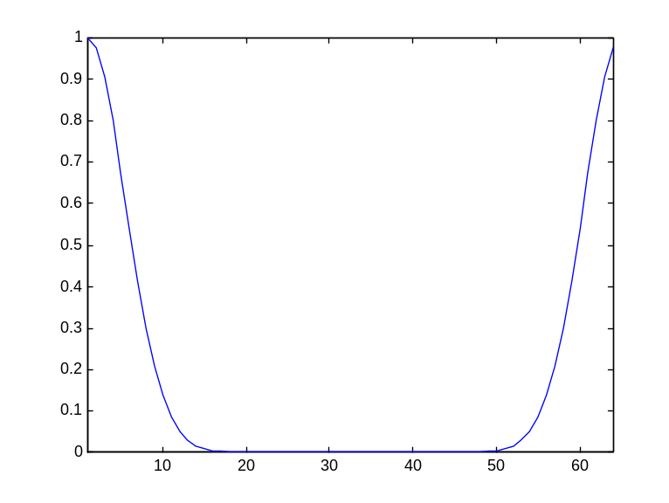
1D FT - fftshift
Use fftshift
  >>L1 = fft(fftshift(l));
abs (L1)
l
phase (L1)
1
33
64
1
33
64
sample #
sample #
0
x_{max}
0
f_{N}/2
f_{N}
x [Matlab]
u

Slide 15
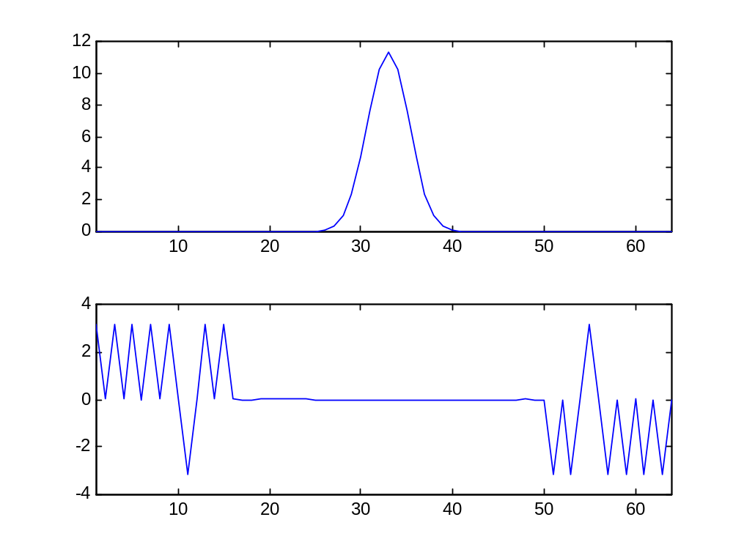
1D FT - 2xfftshift
abs (L2)
Center Fourier Domain
  >>L2 =
  fftshift(fft(fftshift(l)));
phase (L2)
1
33
64
sample #
-f_{N}/2
0
(N-1)/N*f_{N}/2
u

Slide 16
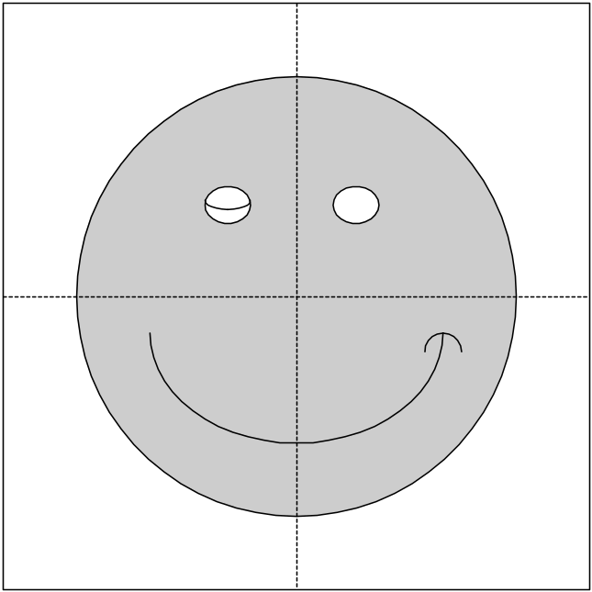
fftshift in 2D
Use fftshift for 2D functions
  >>smiley2 = fftshift(smiley);

Slide 17
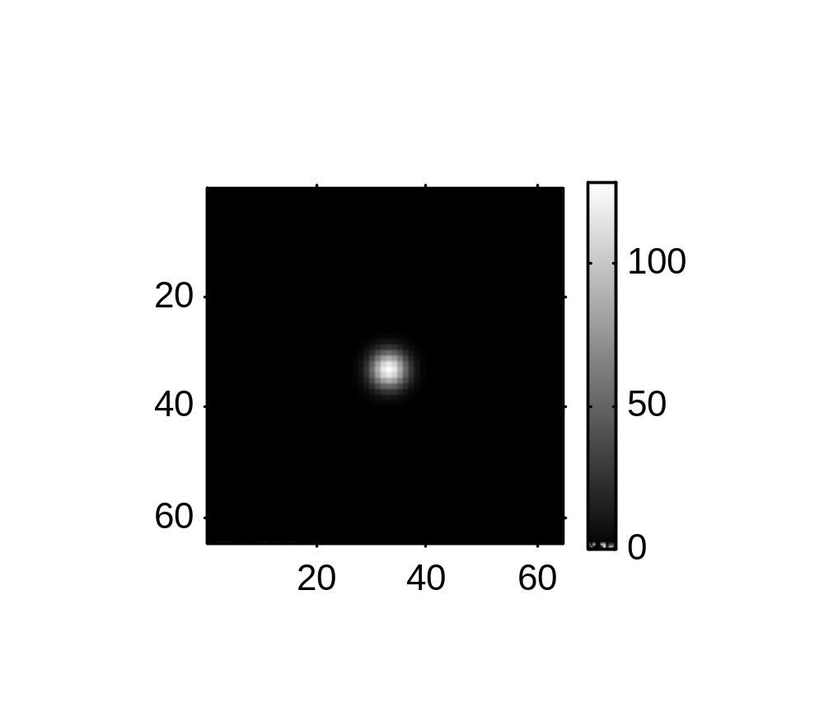
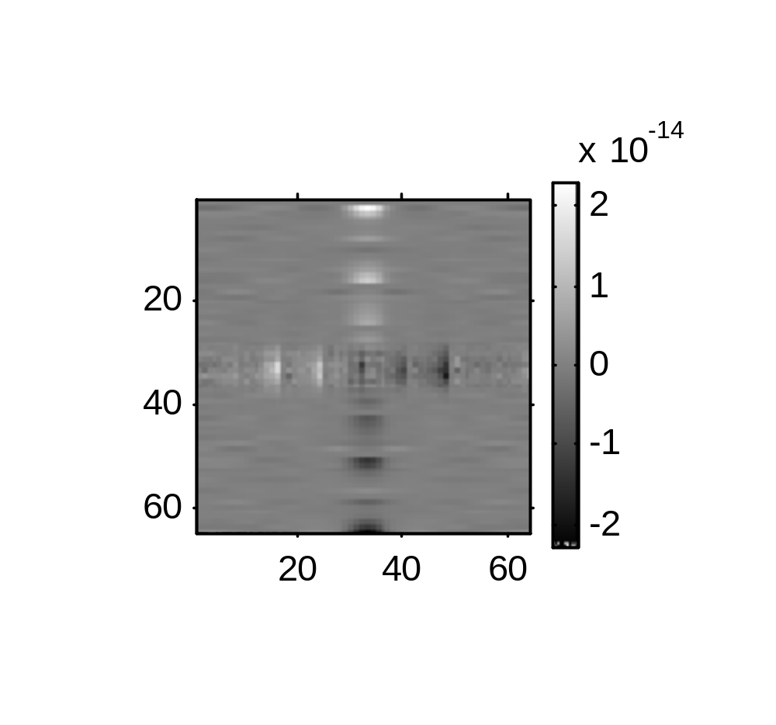
2D Discrete Fourier Transform
  >>Z=fftshift(fft2(fftshift(z)));
  >>whos
  >>figure
  >>imshow(real(Z))
  >>imshow(real(Z),[])
  >>colorbar
  >>figure
  >>imshow(imag(Z),[])
  >>colorbar
Real (Z)
Imag (Z)

Slide 18
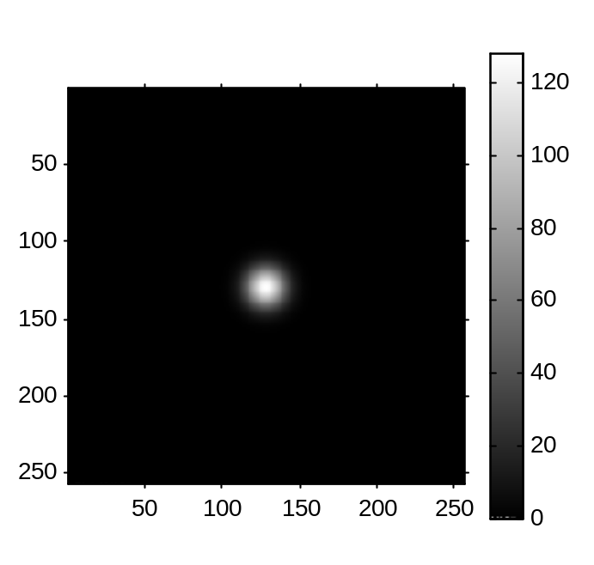
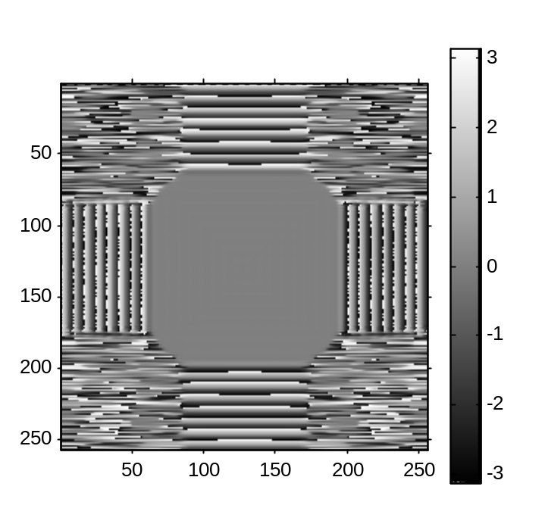
2D DFT - Zero Filling
Interpolating Fourier space by zerofilling in image space
  >>z_zf = zeros(256);
  >>z_zf(97:160,97:160) = z;
  >>Z_ZF = fftshift(fft2(fftshift(z_zf)));
  >>figure
  >>imshow(abs(Z_ZF),[])
  >>colorbar
  >>figure
  >>imshow(angle(Z_ZF),[])
  >>colorbar
Magnitude (Z_ZF)
Phase (Z_ZF)

Slide 19
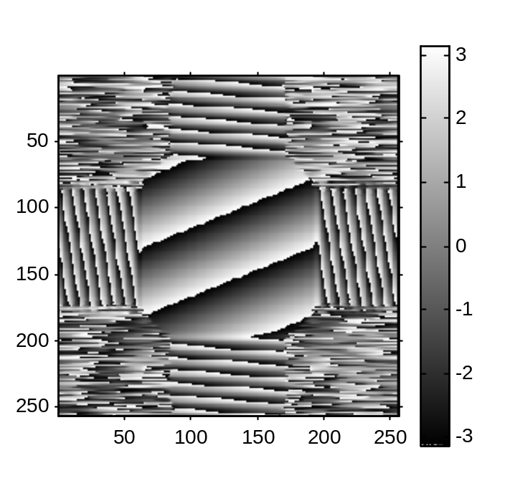
2D DFT - Voxel Shifts
Shift image: 5 voxels up and 2 voxels left
  >>z_s = zeros(256);
  >>z_s(92:155,95:158) = z;
  >>Z_S = fftshift(fft2(fftshift(z_s)));
  >>figure
  >>imshow(abs(Z_S),[])
  >>colorbar
  >>figure
  >>imshow(angle(Z_S),[])
  >>colorbar
Magnitude (Z_S)
Phase (Z_S)

Slide 20
Review of functions …
Input / Output
  >>imread
  >>imwrite
  >>imfinfo
Image Display
  >>imshow
Others
  >>axis
  >>colorbar
  >>colormap
  >>meshgrid
  >>fft, fft2
  >>fftshift

Slide 21
More useful functions …
Image Display
  >>title
  >>xlabel, ylabel
  >>subimage
  >>zoom
  >>mesh
Others
  >>imresize
  >>imrotate
  >>imhist
  >>conv2
  >>radon
  >>roipoly
Demos in Image Processing Toolbox
  >>help imdemos

Slide 22
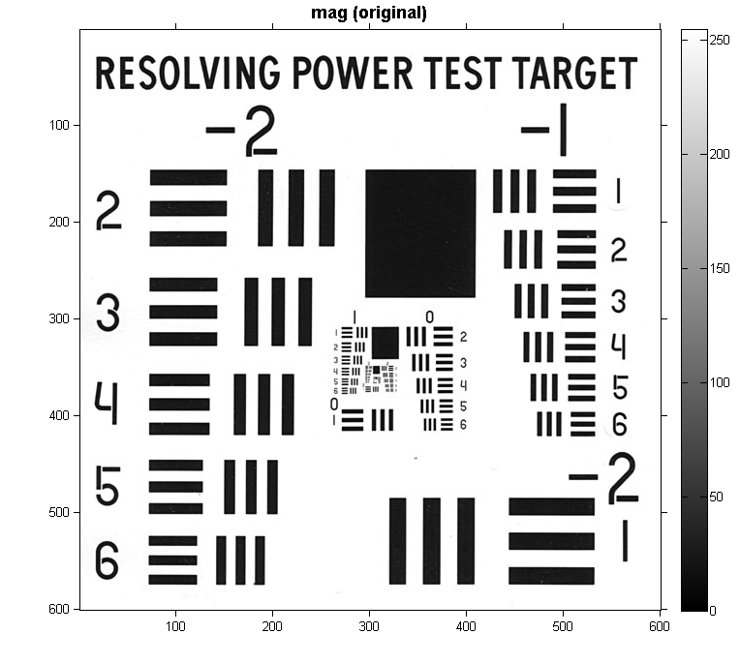
Tips on Image Display – HW 3
>>fname = 'test_pattern.png';
>>temp = imread(fname);
>>im_orig = double(temp);
>>% show original test image
>>imshow(im_orig,[]);colorbar;axis on;truesize
>>title('mag (original)','FontSize',14,'FontWeight','bold')

